Slide 1
NE 591: Advanced Reactor Materials
Fall 2021
Dr. Benjamin Beeler

Slide 2
Last Time
Wrapped up TRISO particle-based reactors
Walked through a number of different fuel failure mechanisms
Current state of TRISO fuel performance modeling
Advanced concepts in TRISO

Slide 3
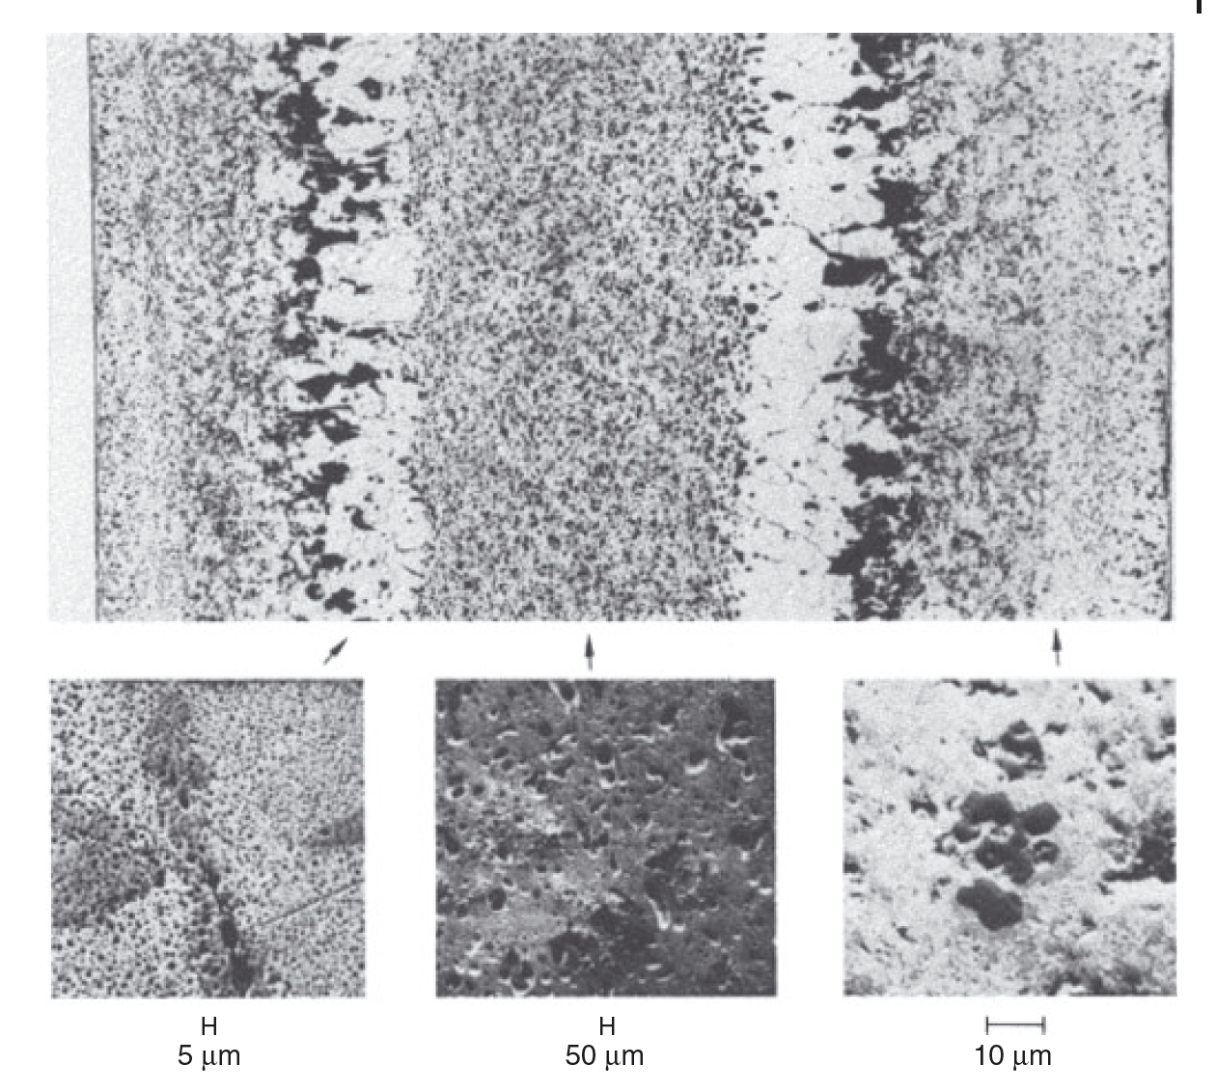
Variable Porosity
The porosity development depends on the phases present in the fuel
In all alloys, the high-temperature cubic U γ-phase exhibits the characteristic large interconnected bubbles similar to those observed in pure γ uranium, whereas at lower temperatures, where the U α-phase predominates, the characteristic tearing-type porosity is evident
In U-Zr alloys, low-temperature U α-phase and Zr δ-phase form a laminar microstructure and the pore morphology follows this microstructure

Slide 4
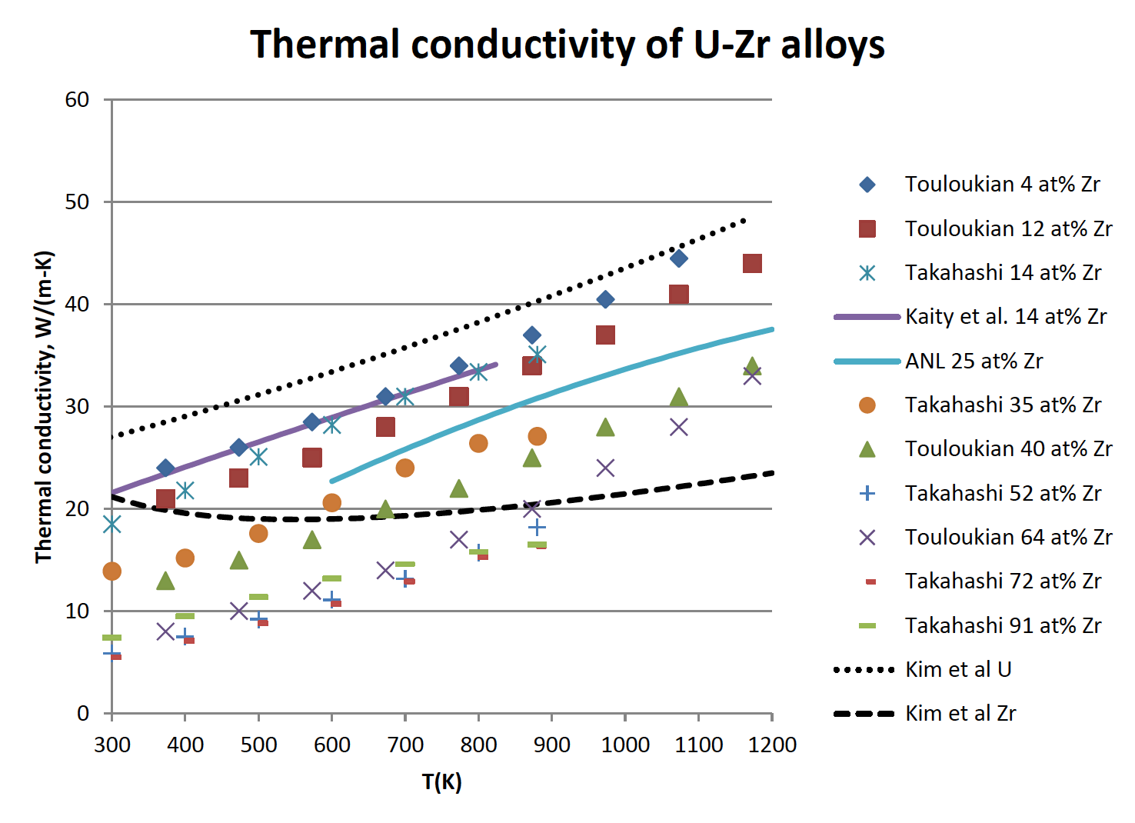
Changes in Thermal Conductivity
U-Zr has a very high thermal conductivity compared to oxide fuels
However, developing porosity will degrade the thermal conductivity
Understanding the temperature also governs how our porosity will develop and how redistribution will vary axially
This is a coupled problem that is complex, but critical for prediction of fuel evolution

Slide 5
Changes in Thermal Conductivity
U-Zr has a very high thermal conductivity compared to oxide fuels
However, developing porosity will degrade the thermal conductivity
Understanding the temperature also governs how our porosity will develop and how redistribution will vary axially
This is a coupled problem that is complex, but critical for prediction of fuel evolution

Slide 6
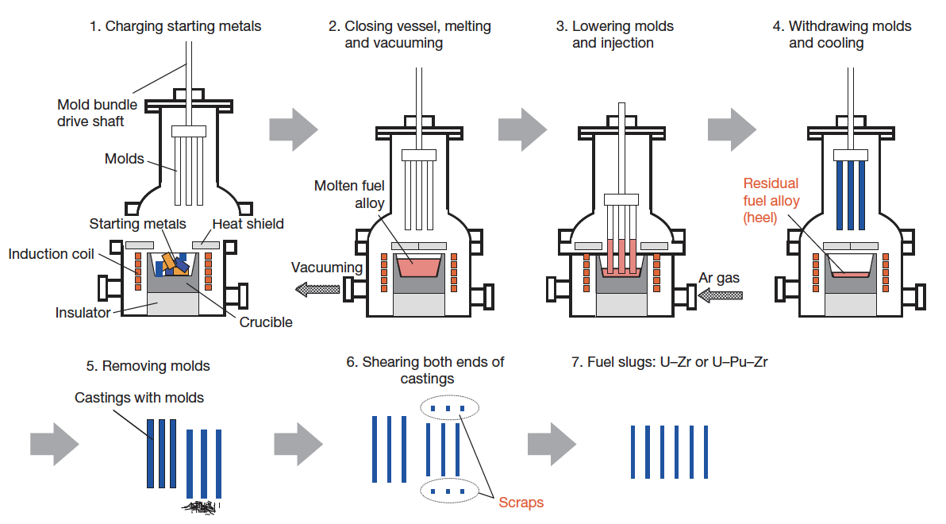
Metal Fuel Fabrication
Injection casting has been utilized for fuel slug fabrication
Remote fabrication has been performed inside a hot cell on recovered uranium
Fuel slugs for EBR II and FFTF were fabrication via injection casting

Slide 7
Metal Fuel Fabrication
Starting materials are charged into the graphite crucible in the furnace
Silica molds with tops closed are set above the crucible
Crucible is coated with yttria
Molds coated with zirconia

Slide 8
Metal Fuel Fabrication
Furnace closed and filled with Ar gas
Crucible is inductively heated to 1830K, and stirred electromagnetically
Ar gas removed, molds are lowered, then Ar gas returned
Pressure difference injects the melt into the molds

Slide 9
Reprocessing
Pyroprocessing
In the electrometallurgical
process, irradiated metal fuel is anodically dissolved
While uranium is deposited on the solid cathode, plutonium is collected in the liquid cadmium cathode with uranium, minor actinides (MA: Np, Am, Cm), and part of the lanthanide fission products
This inherently low-decontamination aspect brings about a proliferation- resistant feature to the electrometallurgical process

Slide 10
Reprocessing
Pyroprocessing
Can reduce the repository burden of radioactive waste by separating long-lived MA from spent light-water reactor fuel, burning MA in fast reactors, and decreasing the long-term radioactivity of nuclear waste
Metal-fueled fast reactors facilitate the effective transmutation of MA because of the high-energy neutron spectrum
One of the measures to load MA into the reactor core is to add MA to the fuel alloy homogeneously

Slide 11
Refabrication
Injection casting
These technologies are expected to reduce the fuel cycle cost even for small-scale fuel cycle plants because of the simplicity of the process and the compactness of the equipment
For example, in the injection casting process, composition adjustment, melting (alloying), and casting of the fuel slug can be done in a single injection-casting furnace

Slide 12
Metal Fuel
Introduction
Fabrication
Constituent Redistribution
Swelling and Fission Gas Release
FCMI
FCCI
Fission Product Behavior
Factors Controlling Fuel Lifetime

Slide 13
Mixed oxide fuel

Slide 14
Mixed Oxide (MOX) Fuel
Introduction
Fuel Restructuring
Constituent Redistribution
Geometrical Evolution
Evolution of O/M ratio
Migration of Fission Products
Fission Gas Release
Life Limiting Phenomena

Slide 15
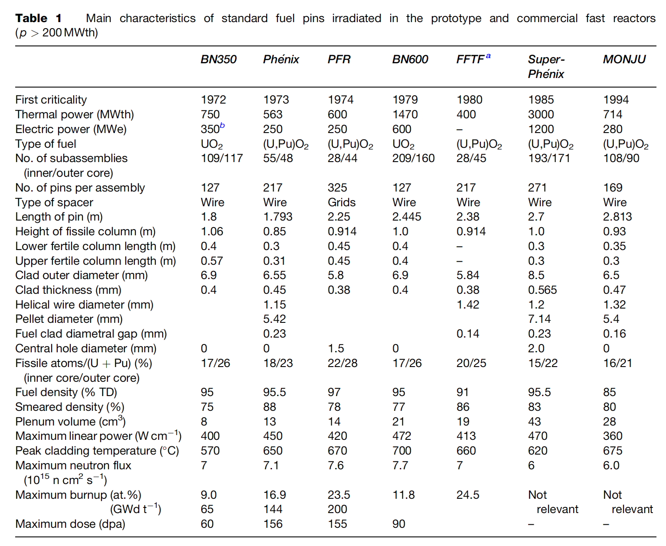
MOX Introduction
Despite some disadvantages, such as its low U density, poor thermal conductivity, and its chemical reaction with sodium, MOX fuel (U,Pu)O2 is the fuel that has been used most in fast reactors
In order to avoid the dramatic swelling of metallic fuels, MOX fuels were explored in fast reactors
Behavior was observed to be satisfactory and was relatively widely implemented in SFRs

Slide 16
Geometry
The fuel pin 2–3m long, 5–10mm diameter, clad in a steel tube 0.4–0.6mm thick closed in both ends by welded plugs

Slide 17
Sodium coolant

Slide 19
pyroprocessing

Slide 23
Questions?

